Slide 1
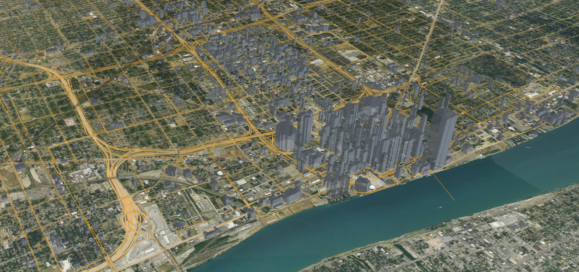
ANTARES 3D Visualizer
Griffin White
Transportation Systems and Mobility Group
Argonne National Laboratory

Slide 2
ANTARES 3D Visualizer
The 2024.3 release of POLARIS has a 3D Visualizer for Windows, named ANTARES
  Can run during the simulation or using previously generated output
ANTARES creates a new window to view the simulation from
Currently, POLARIS must be recompiled with flags set to enable ANTARES
  Separate “Integrated_Model_Antares.exe” included with distribution of POLARIS

Slide 3
Motivation
Why put a video game on top of POLARIS?
  Visualizing data instead of relying on SQL, HDF5, etc output
Demonstration
  Far easier to understand different scenarios at a glance
Bugfixing
  Investigate errors and strange results by watching traffic unfold, instead of digging into files immediately
  Rerun or replay an erroneous run to track the error

Slide 4
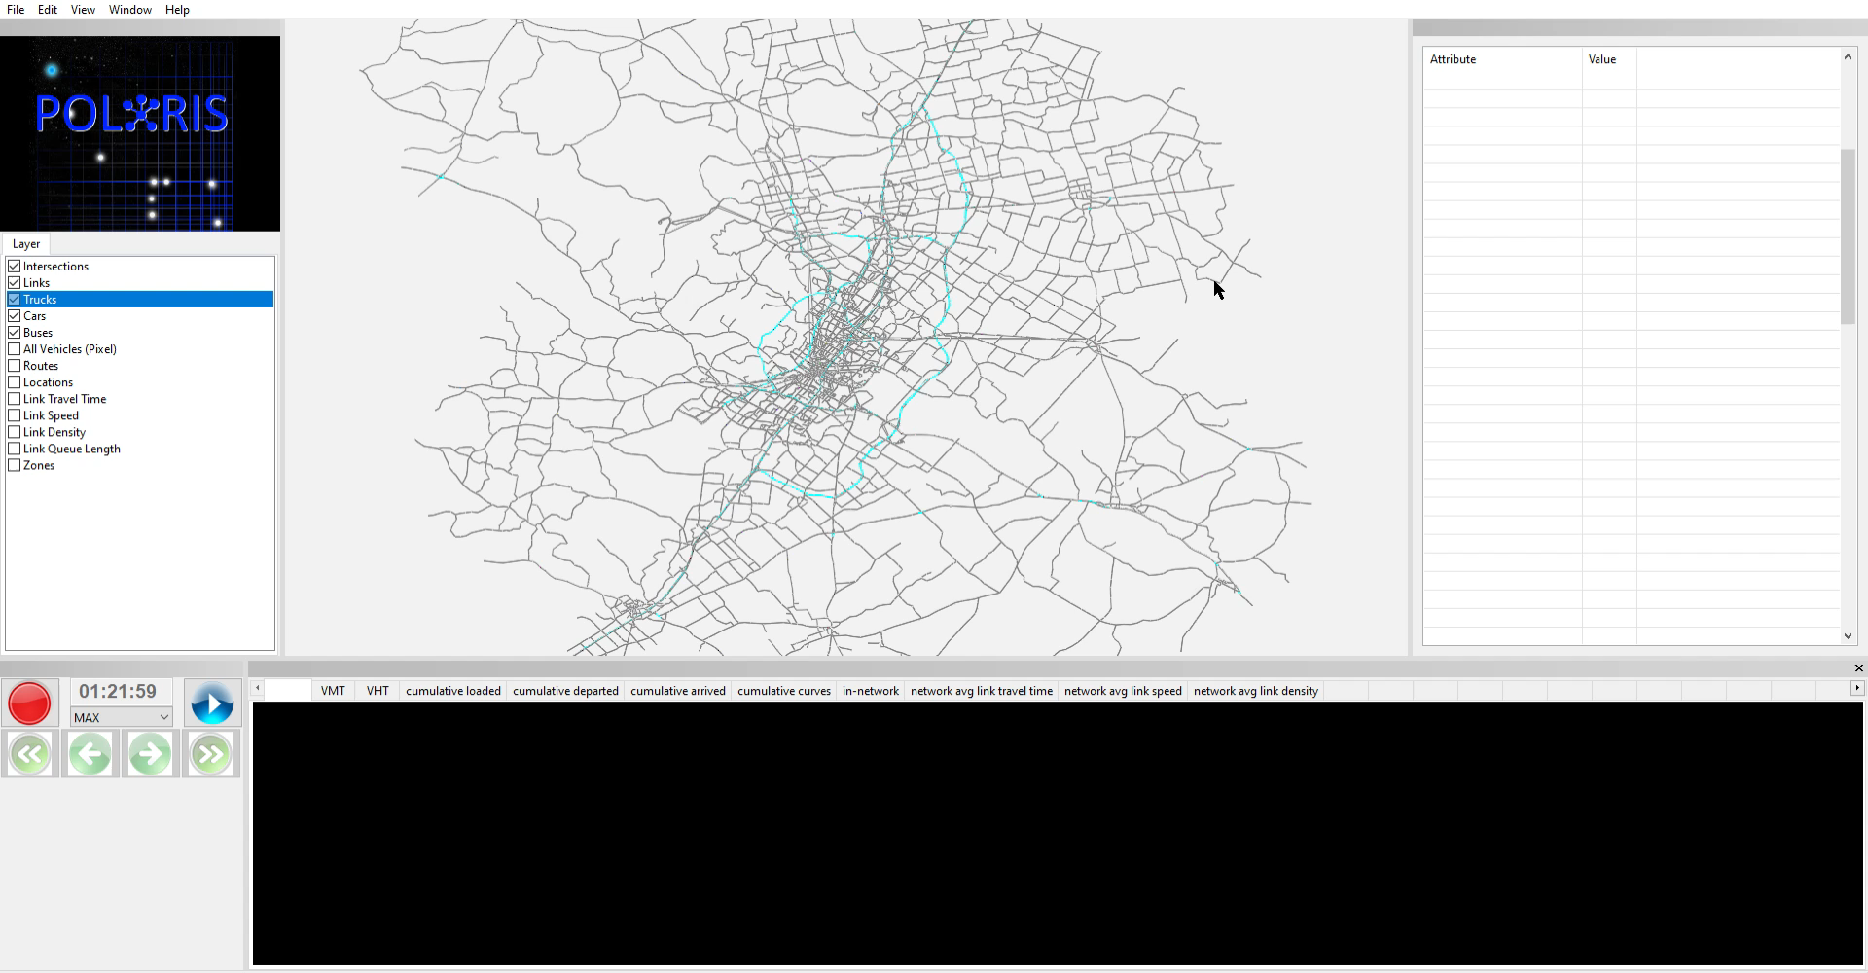
ANTARES 3D Visualizer

Slide 5
Building the 3D Visualizer
When building from source code, ANTARES can be enabled with the following flags from the build Python script
  python ./build.py –c –e antares
Disabled with the following:
  python ./build.py –c –e -antares
Building POLARIS from this configuration generates new executables:
  Integrated_Model_Antares.exe
  Output_Visualizer.exe
The dependencies package contains everything needed for ANTARES in the “Antares” folder
  ANTARES requires several .dll files in the same directory as the executable to run

Slide 6
Getting Help

Slide 7
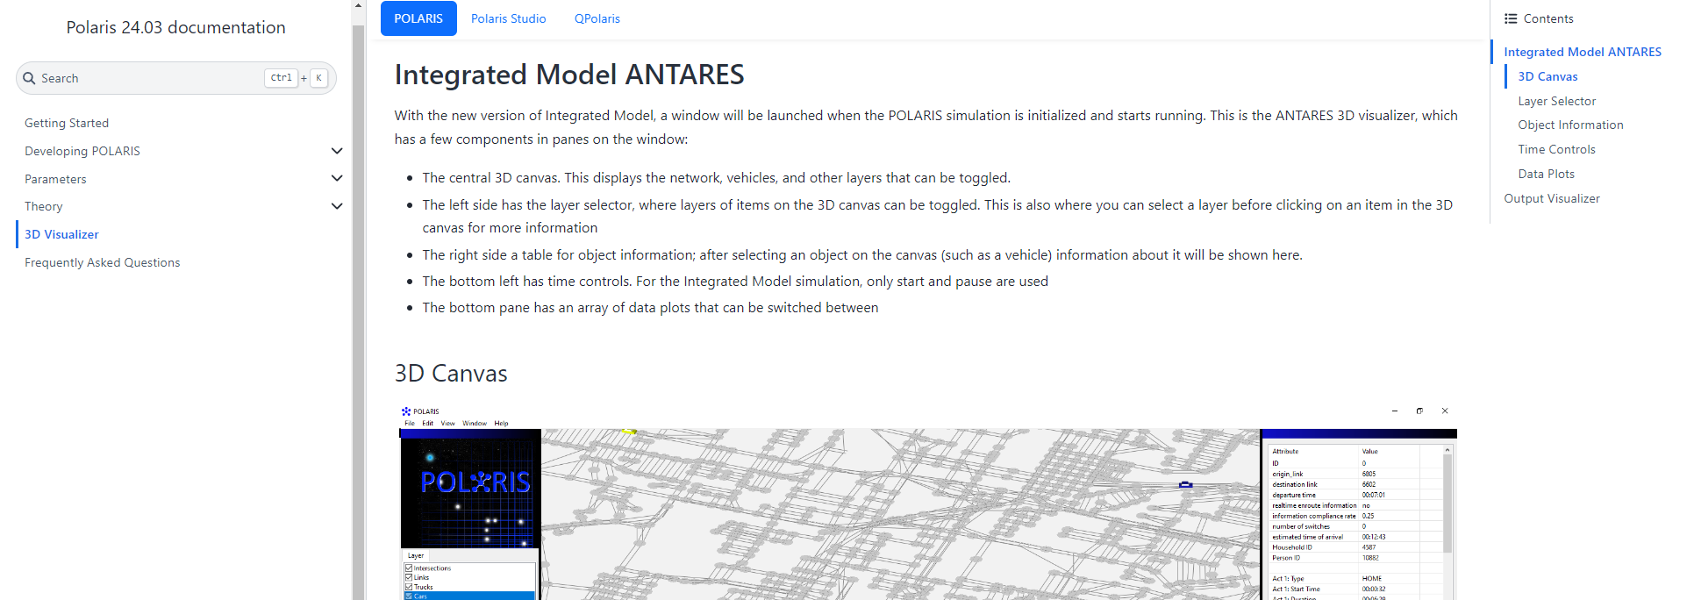
Documentation
Documentation for the 3D Visualizer is available on the POLARIS documentation webpage: https://polaris.taps.anl.gov/polaris/visualizer/index.html

Slide 8
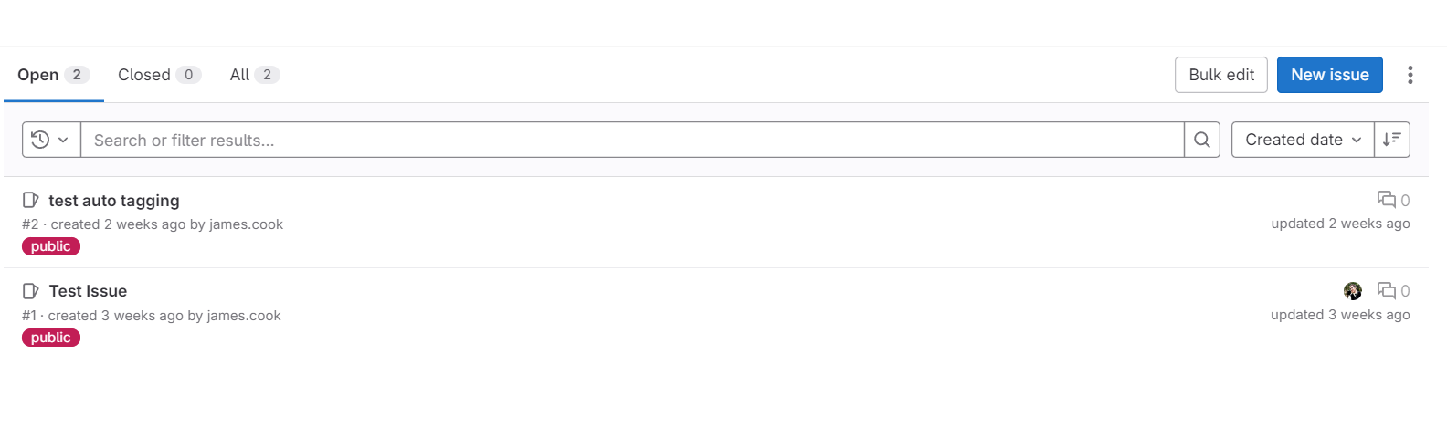
GitLab Issues Board
ANTARES is a work in progress and issues are expected
Public issues board on GitLab: https://git-out.gss.anl.gov/polaris/issues/-/issues
Report bugs, request features and look for others who are already talking about the issues!

Slide 9
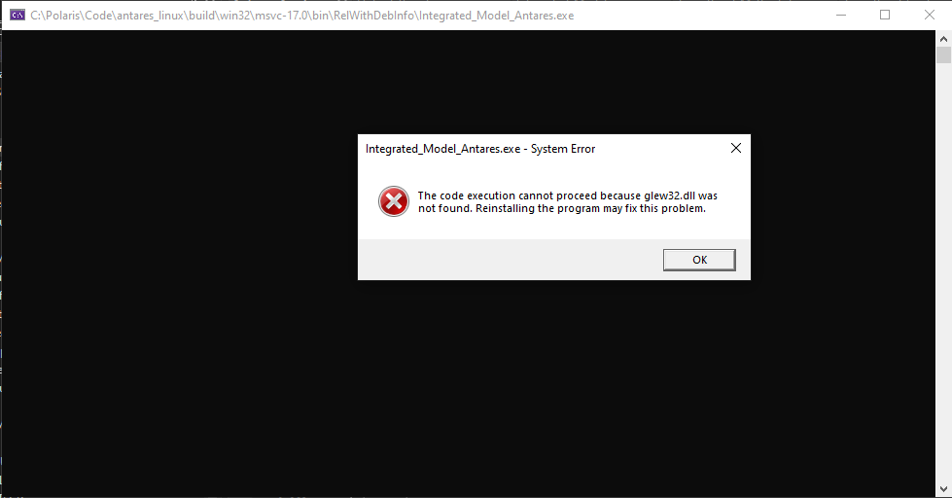
Work in Progress
ANTARES is available in the release version of POLARIS, but it is considered a work-in-progress
  Even more so than the rest of POLARIS!
Bugs and incomplete features are expected at this point
Major changes are already planned – feel free to make suggestions!

Slide 10
Using ANTARES

Slide 11
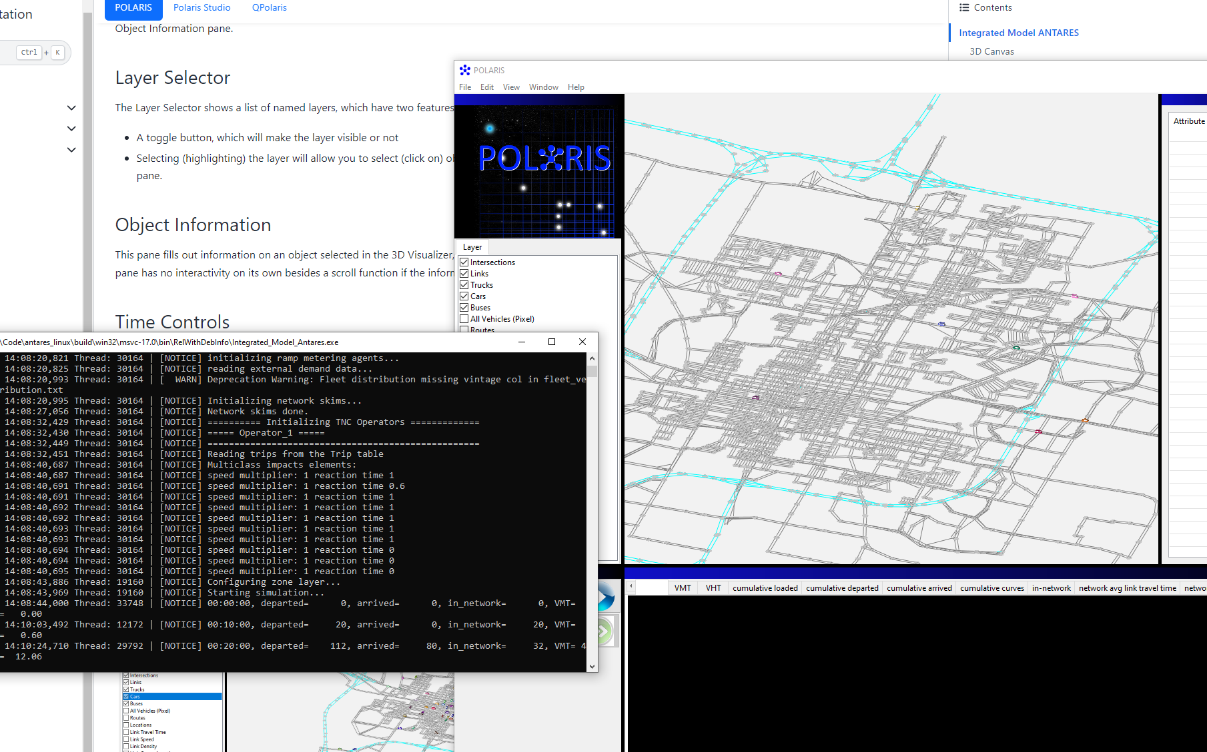
During Simulation
Integrated_Model_Antares.exe
Runs on top of the regular POLARIS simulation
  No difference besides time controls
  Simulation can be paused and slowed down to inspect elements more easily

Slide 12
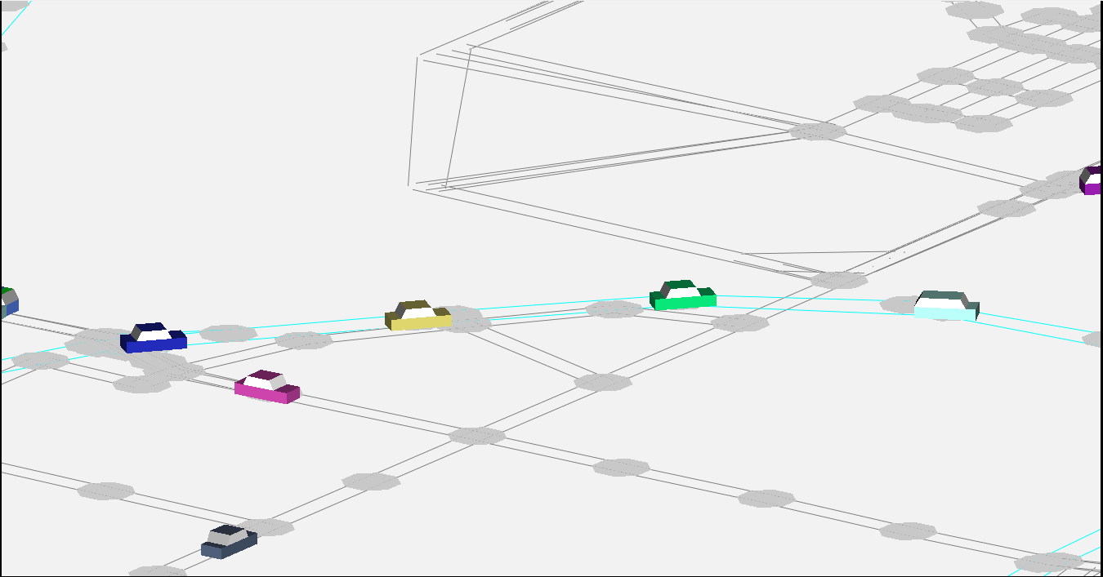
During Simulation
Traffic networks and vehicle locations are taken directly from the POLARIS simulation
  3D view matches what the simulation is working on
Link types are color coded – Blue highways, other roads gray
Vehicles are assigned colors and shapes based on type and use

Slide 13
Output Visualizer
Output_Visualizer.exe
Takes output from a previous ANTARES run and creates a window to visualize it
Has finer tuned time controls allowing the user to skip forward and back in the simulation
Does not support every feature from real-time ANTARES
  2D (Pixel) Vehicles only
  Agents do not have as much information available
  Data Plots are not displayed
The replayed simulation does not need to be finished - you can replay a crashed or failed run

Slide 14
Snapshot Files
In addition to Supply files for generating the network, the Output visualizer requires two snapshot files for creating vehicles
Binary (snapshot.bin)
  Contains vehicle locations and color, etc.
Index (snapshot.idx)
  Contains timestep and vehicle count information
Files generated by a previous ANTARES run
  Generating with regular POLARIS runs is on the way

Slide 15
ANTARES FEATURES

Slide 16
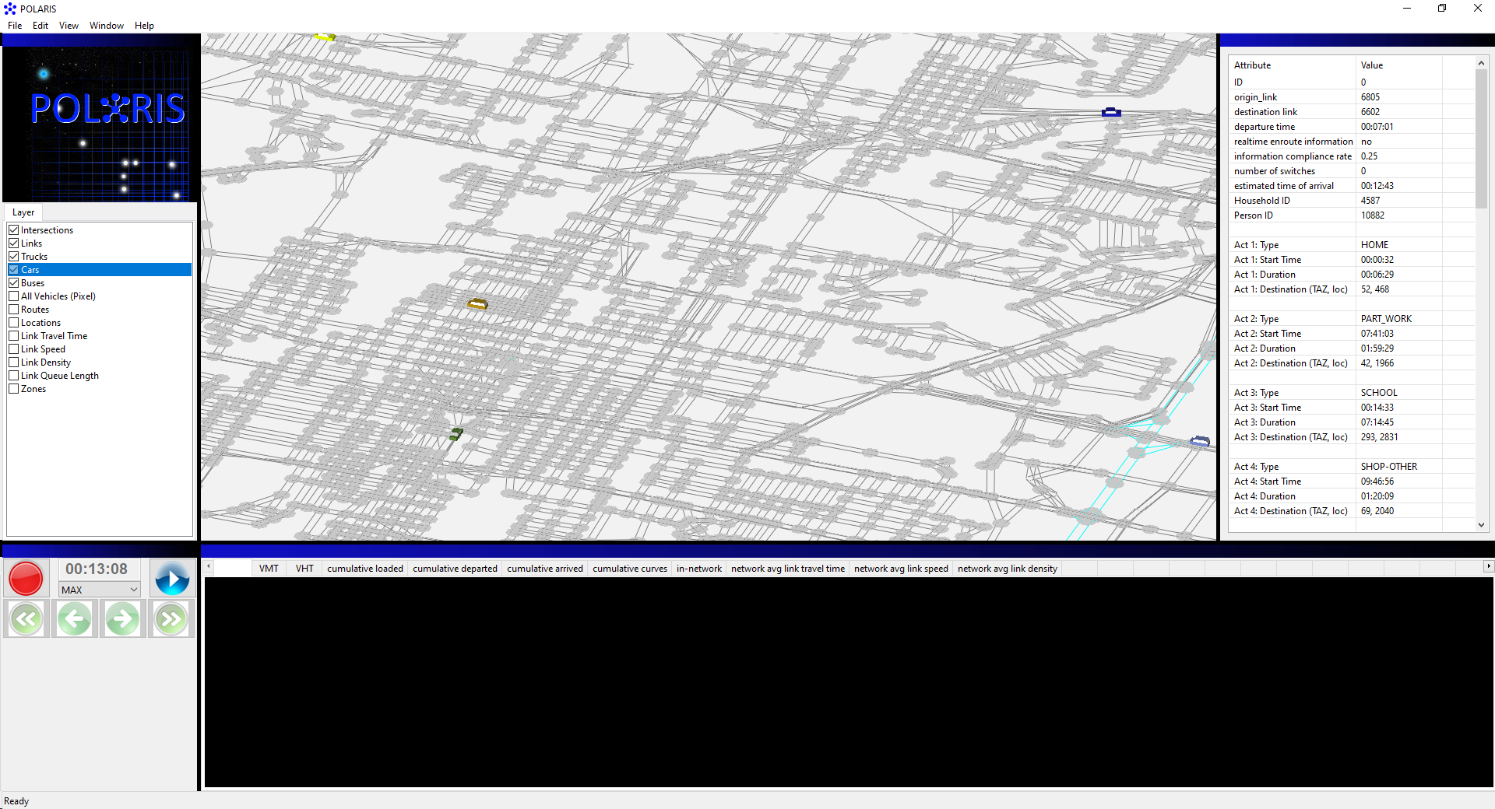
3D Canvas
Central pane contains all 3D objects in the simulation
Vehicles, links, intersections
Routes, locations, and other agent-specific features

Slide 17
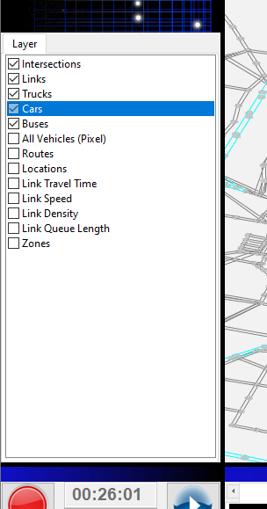
Layers Pane
Left pane has list of 3D Layers in the Canvas
Layers can be toggled on and off to focus on areas of interest
Selecting a layer allows the user to click on specific objects
  Select Cars to choose a car and view its info, etc.
Some layers may be visible only when paused, or when another object is already selected

Slide 18
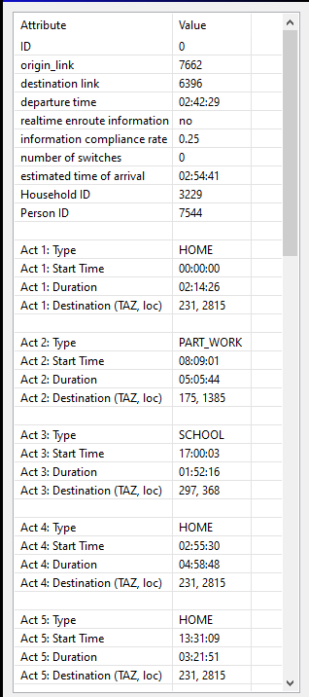
Agent Info
Clicking on agents in the selected layer in the 3D Canvas will bring up information for that agent
  Current focus is on vehicles, but other items will have info available in the future
Vehicles show information on itself as well as the household, driver, and planned activities
  ID values can be cross referenced with other POLARIS output data files

Slide 19
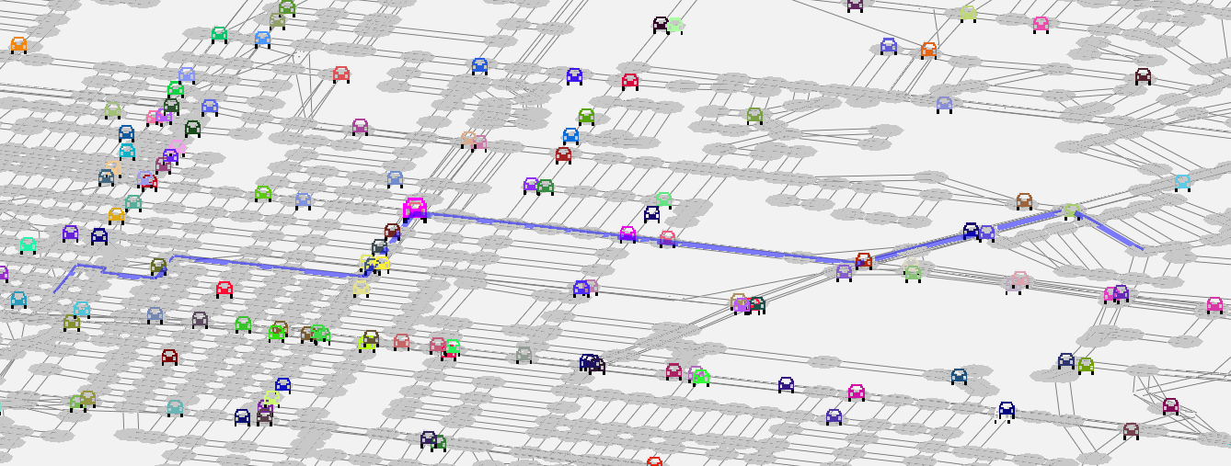
Agent Info – Extra Layers
After selecting a vehicle, some additional layers will be available to visualize more information about that agent
  Planned routes can be highlighted when a vehicle is selected

Slide 20
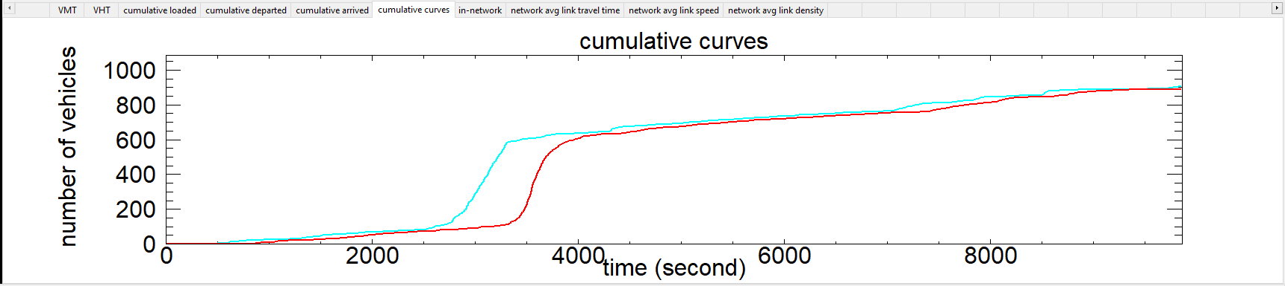
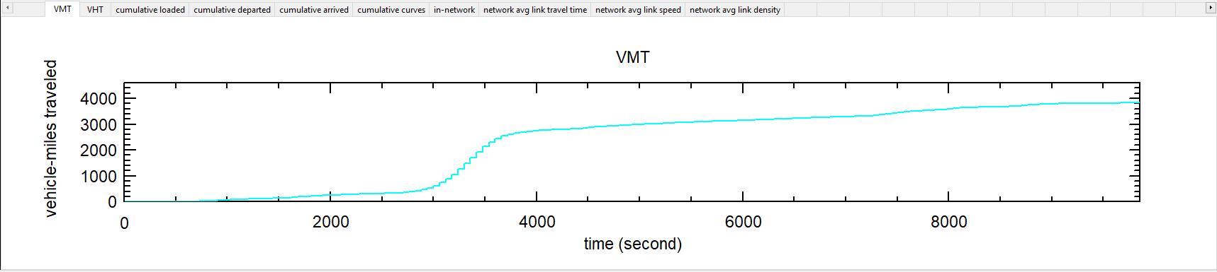
Data Plots
Lower pane has a book of pages with data plots from the simulation
Data plots use data from network and links

Slide 21
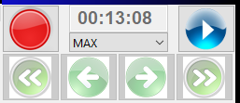
Time Controls
The lower left pane has controls for simulation time in ANTARES
Pause/Start
Runtime speed
  Default to max/unrestrained
  When another value is selected, runtime is restrained to make it easier to watch
Skip forward/back
  Only available in Output Visualizer

Slide 22
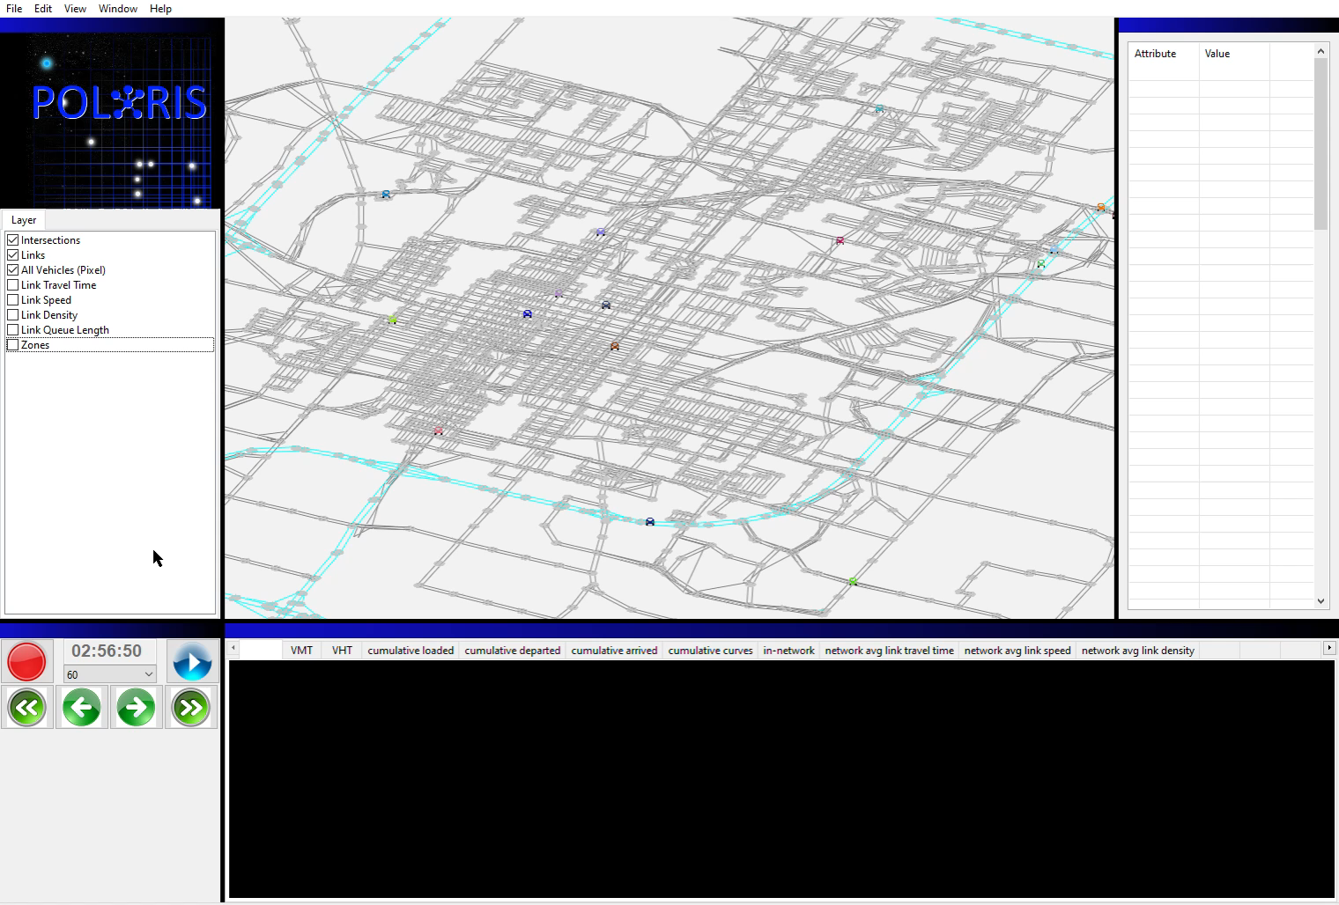
Replay Time Controls
Since the Output Visualizer has all the info it needs saved to file, we can skip around the simulation
  Either by 1 hour or 1 minute
Skipping around the simulation requires the visualizer to load data from file, so may take a moment

Slide 23
Future Improvements
Continuous Bug fixing
  Report bugs through the public GitHub issues page!
Visual improvements
  Satellite image of ground, 3D buildings, etc
Built-in video recorder
Interactivity for network events – options to disable network links, etc.
Reconfigure visualizer as a library – available without recompiling POLARIS
Replace proprietary graphics engine with a more advanced option (game engines, etc.)

